Slide 1


Brain Tumor Detection And Classification Using
Transferred Learning
Domain : Machine Learning / Deep Learning
Team Members :
Name - Reg No
Ajith Singh - 111521204001
Bharath M -111521204005
Project Guide
Dr. Sudharson, B. Tech., M.E (P.hd).
ASSISTANT PROFESSOR

Slide 2
ABSTRACT
Brain cancers caused by malignant brain tumors are one of the most fatal cancer types with a low survival rate mostly due to the difficulties in early detection.
Medical professionals therefore use various invasive and non-invasive methods for detecting and treating brain tumors at the earlier stages thus enabling early treatment.
The main non-invasive methods for brain tumor diagnosis and assessment are brain imaging like computed tomography (CT), positron emission tomography (PET) and magnetic resonance imaging (MRI) scans.
By using these imaging they manually classify the images and detect the tumor cells. while doing this there will be errors and mislead classification. So, they introduced CNN models on 2010 to solve this issue but it was inaccurate
By rapid growth of neural models in the field of Computer vision and image analysis the introduction of transferred learning in the NLP changed the way of image processing by transferring the representation from one model to another to increase the model complexity and accuracy

Slide 3
INTRODUCTION
Brain tumors are a significant health concern worldwide, with millions of individuals being affected by them each year. The detection and accurate classification of brain tumors are critical for effective treatment planning and patient outcomes. Conventional methods of diagnosis, including manual interpretation of medical images, can be time-consuming and prone to human error. This is where modern technology, specifically deep learning and convolutional neural networks, plays a transformative role.
In this presentation, we will explore the pressing need for accurate brain tumor detection and classification in MRI scans, and how the integration of transfer learning and the VGG16 model, a pre-trained deep learning architecture, is revolutionizing this aspect of medical imaging.

Slide 4
Existing System
Existing systems had several limitations that prompted the exploration of more advanced and accurate approaches:
Automation : Automated systems were typically rule-based and struggled with variations in tumor size, shape, and location.
Lack of Scalability : Conventional methods could not easily scale to handle the increasing volume of medical imaging data generated by healthcare institutions.
Diagnostic Challenges : Conventional systems struggled to provide precise classifications and differentiate between tumor types.

Slide 5
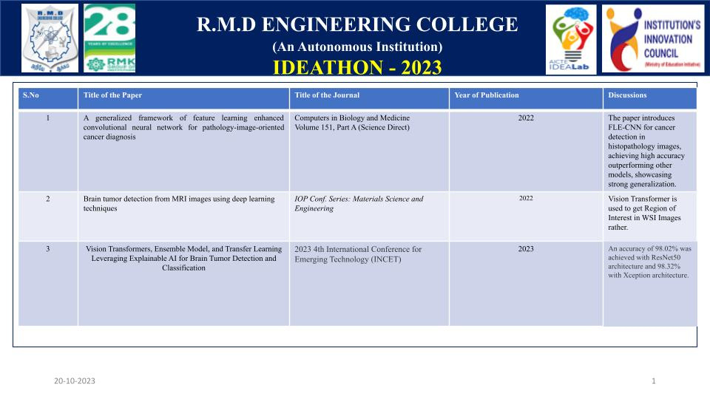
Literature Survey

Slide 6
Proposed System
Transfer learning with VGG16 enabled the development of automated systems capable of accurately detecting brain tumors in MRI scans.
The deep architecture of VGG16 improved the classification of tumors, providing insights into tumor type, size, and location.
The use of pre-trained models reduced the time and resources required to develop and deploy advanced healthcare solutions.
Automated systems provided consistent and reliable results, reducing the risk of human error and improving diagnostic accuracy.
The technology allowed healthcare institutions to scale their diagnostic capabilities to handle the increasing demand for MRI analysis.

Slide 7
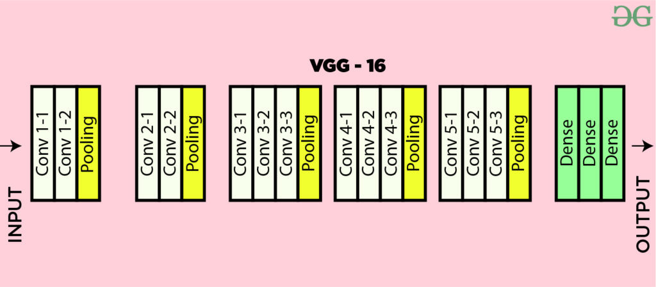
VGG16 Architecture

Slide 8
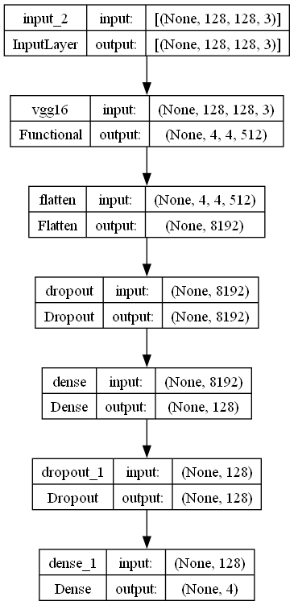

Slide 9
Modules
Data Collection and Integration Module
Data Preprocessing Module
Data Augmentation Module
Data Generator Module
VGG16 Model Module
Training Module
Evaluation Module

Slide 10
Conclusion and Future Enhancement
In conclusion, the integration of transfer learning with the VGG16 model for brain tumor detection and classification on MRI scans represents a monumental step forward in the field of medical imaging and healthcare. This advanced technology offers a myriad of benefits, from automating the detection of brain tumors to improving their accurate classification, thus enabling faster and more precise treatment decisions. By doing so, it addresses the limitations of the previous manual and rule-based approaches, providing consistent, efficient, and scalable solutions for the healthcare sector.
Multi-Modal Data Integration: Future enhancements may involve the integration of multiple imaging modalities, such as PET scans or functional MRI (fMRI) data, to provide a more comprehensive view of the tumor and its effects on the brain.
Integration with Electronic Health Records (EHR): Seamless integration with EHR systems can provide a holistic view of patient data and facilitate better-informed clinical decisions.

